Slide 1

Drone based Survey and Mapping for Bridge Construction Management and Structural Health Monitoring
Presented by
1] Vaishnavi Khilegaon
2] Digpal Jagtap
3] Vaishnavi Ahir
4] Vivek Mahajan
5] Pratik Zodpe
Date: 16-08-2024

Slide 2
Content
Project Info - Objective and Requirements
Designing - Components Info
Assembly and Calibration
Data Acquisition
Data Processing
Conclusion

Slide 3
Introduction
UAVs, also known as drones, are flying robots that can be remotely controlled or autonomously operated using programmed flight systems.
A quadcopter is a type of unmanned aerial vehicle (UAV) with no onboard pilot, controlled either autonomously or remotely.
Quadcopter sizes range from insect-sized to large, depending on the application and equipment required.
Cameras and software on quadcopters can enable imaging-based inspection and analysis in industrial applications.
Quadcopters are multirotor UAVs classified as rotorcraft, lifted and propelled by four rotors.

Slide 4
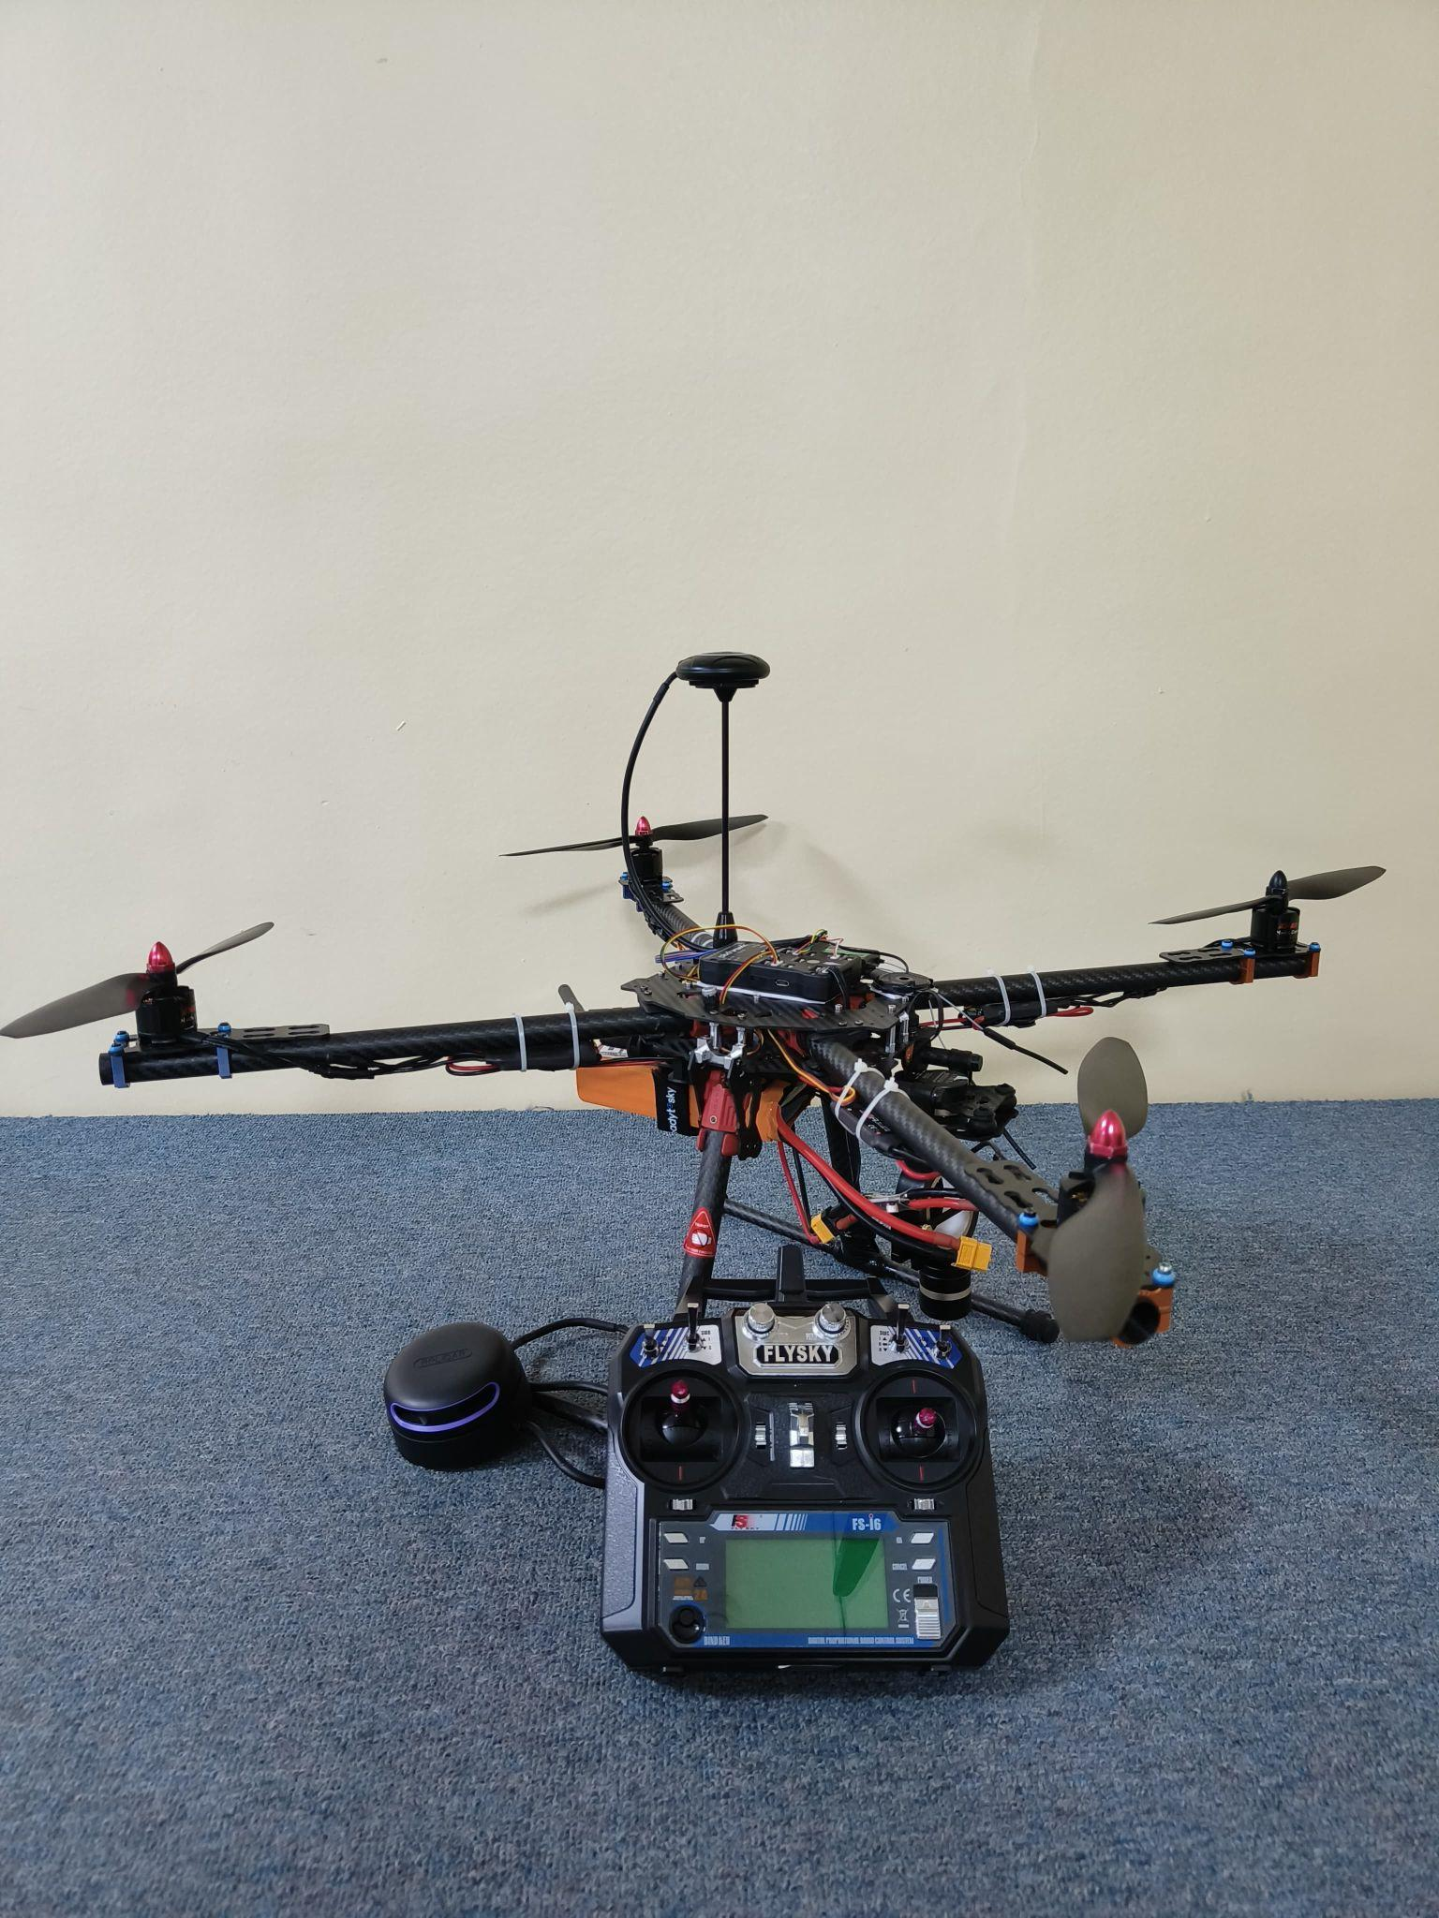
Objective
Develop a versatile wing with legs for enhanced stability and multi-application use.
Maximize flight time with low-cost, minimal design changes for long-duration tasks like monitoring.
Optimize propeller angles and numbers to improve flight efficiency.
Enhance sensor selection and performance analysis for the quadcopter.
Focus on civil applications like structural health management, construction management, and 3D mapping using LIDAR.

Slide 5
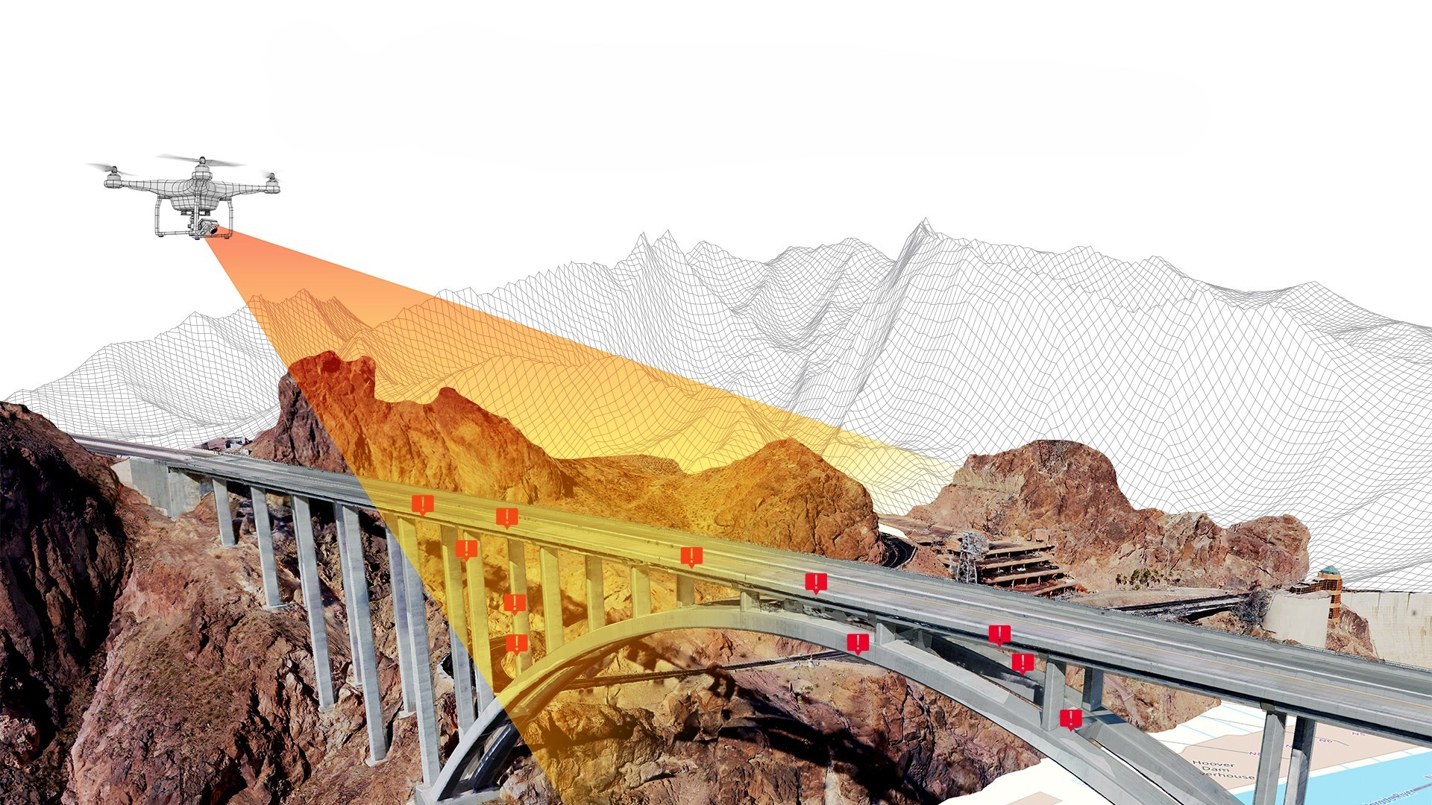
Problem Statement
Time Consuming
Inaccuracy
Labour Intensive
Operational Constraints

Slide 6
Solutions
Covering larger areas in lesser time.
It can have multiple payloads with control over quality of data.
With minimal crew size of 2 person / drone.
Efficient use of resources for optimal planning and execution of construction activity.

Slide 7
Design
Requirements
(Stability, Performance)
Weight of Quadcopter
1.7 kg
Selection of Main Parameters
Frame
Motors
Battery
Propellers
Flight Controller
Sensors
Performance Analysis – Does Design meet Requirements
Optimization – It Is Best Design
Yes

Slide 8
Components
Tarot TL65B01 Iron Man 650: A foldable quadcopter frame with a 650 mm diagonal motor-to-motor distance.
Lithium Polymer Battery 5200 mAh: Power supply for the drone.
Brushless Motors: Rotate propellers to lift the drone.
Electronic Speed Controller (ESC): Controls the speed of the motors.
Pixhawk 2.4.8 Flight Controller: Monitors drone operations.
Propellers: Generate thrust for the drone.
GPS: Provides precise location data.
LIDAR: Creates detailed 2D models of construction sites.
Telemetry: Provides real-time data on position, altitude, direction, and aircraft condition.

Slide 9
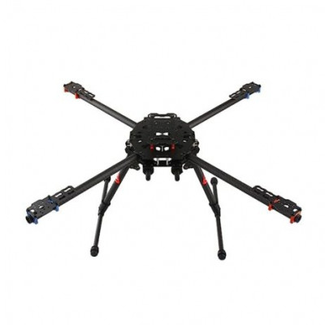
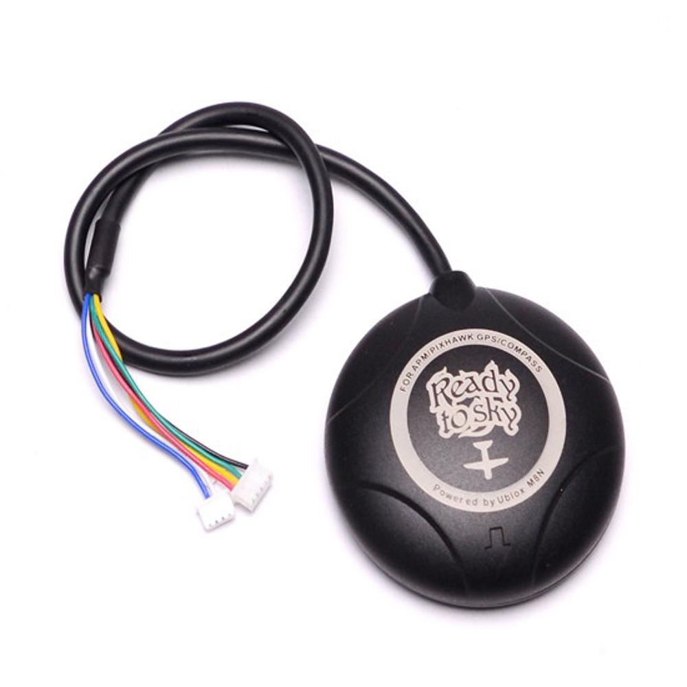
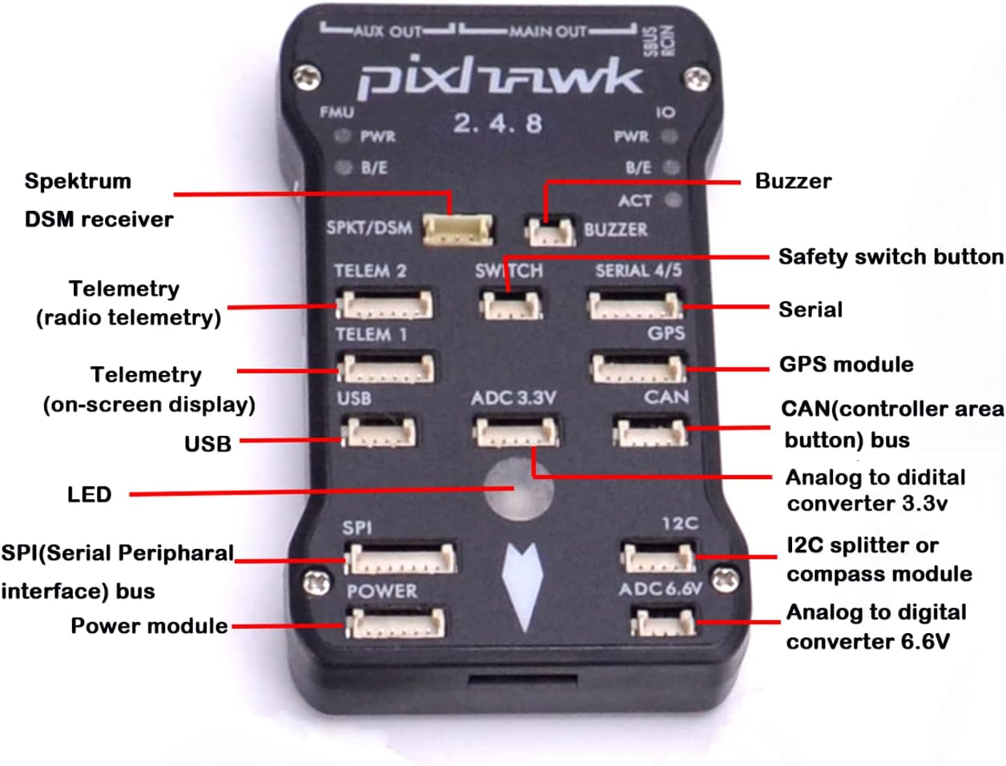
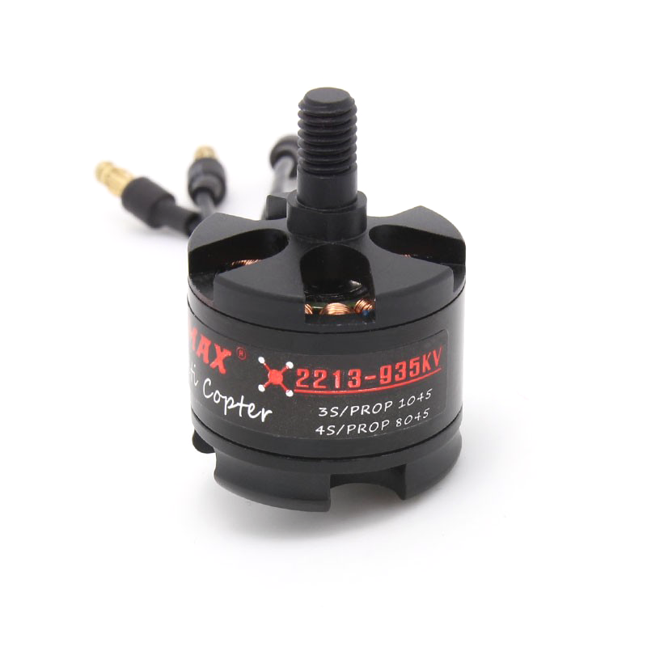
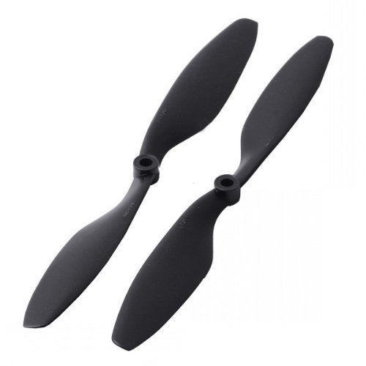
Components

Slide 10
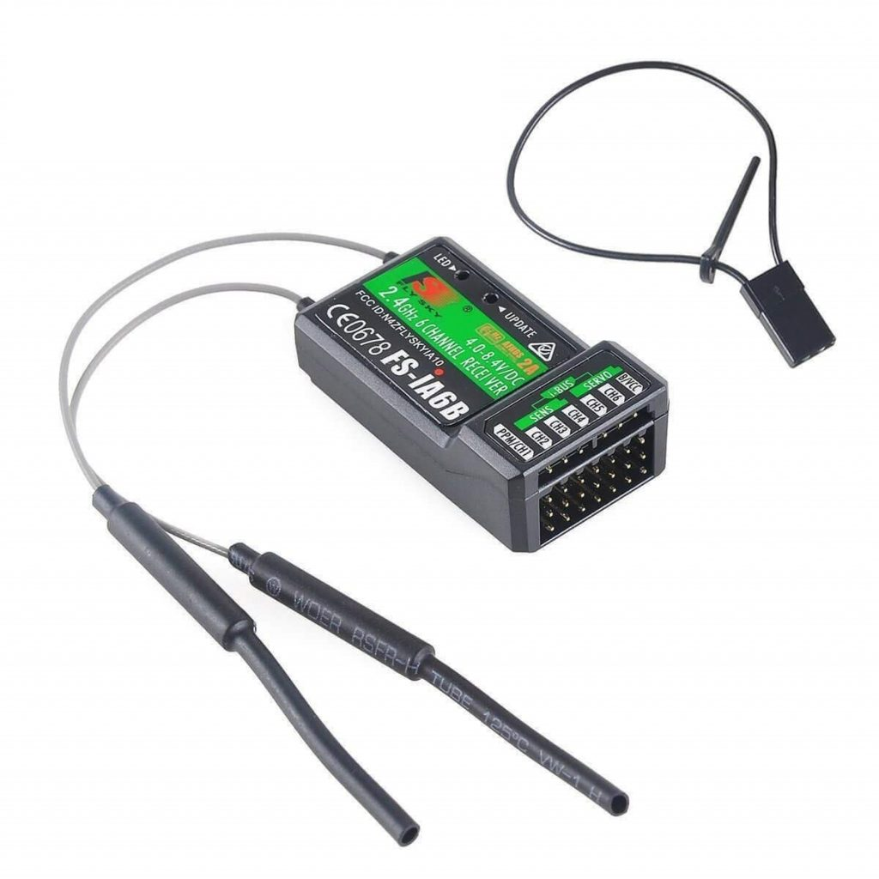
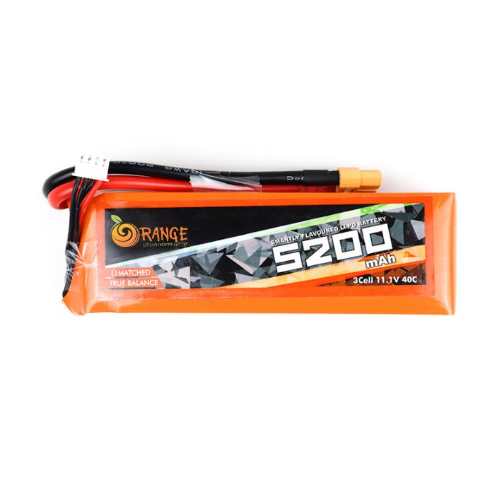
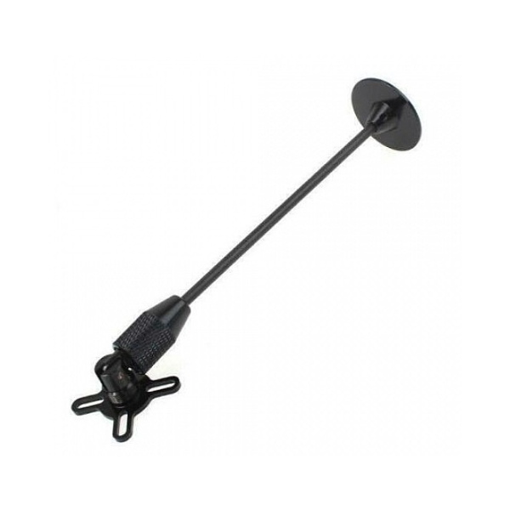
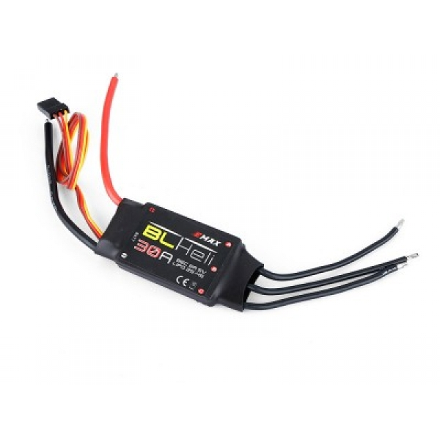
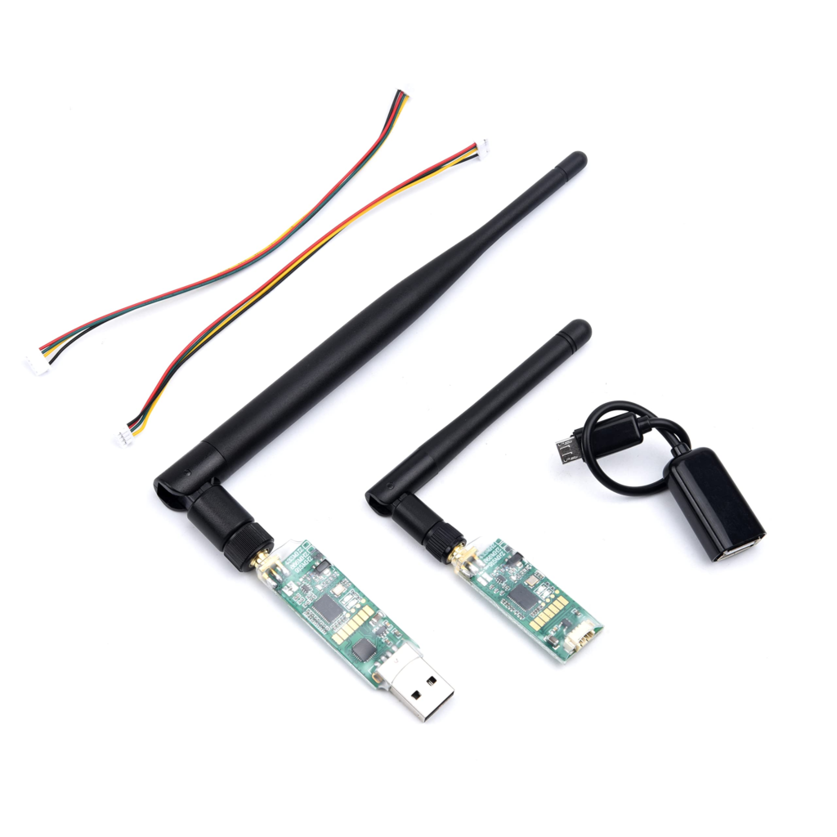
Components

Slide 11
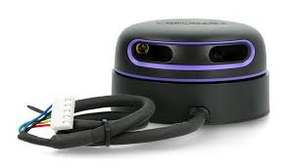
Lidar
RPLIDAR A2M12 is a 2D laser scanner used for precise distance measurement and mapping, ideal for drone-based applications.
It offers a 360-degree panoramic scan with a range up to 30 meters and can perform up to 16,000 samples per second.
High accuracy (±15 mm) and adjustable rotation speeds (5-20 Hz) make it suitable for detailed survey and structural health monitoring.
Its lightweight design ensures minimal impact on drone flight, and it integrates easily with flight controllers for real-time data acquisition.
Robo Studio platform is used for processing and analyzing the data collected by the RPLIDAR, enhancing the efficiency of survey and mapping tasks.

Slide 12
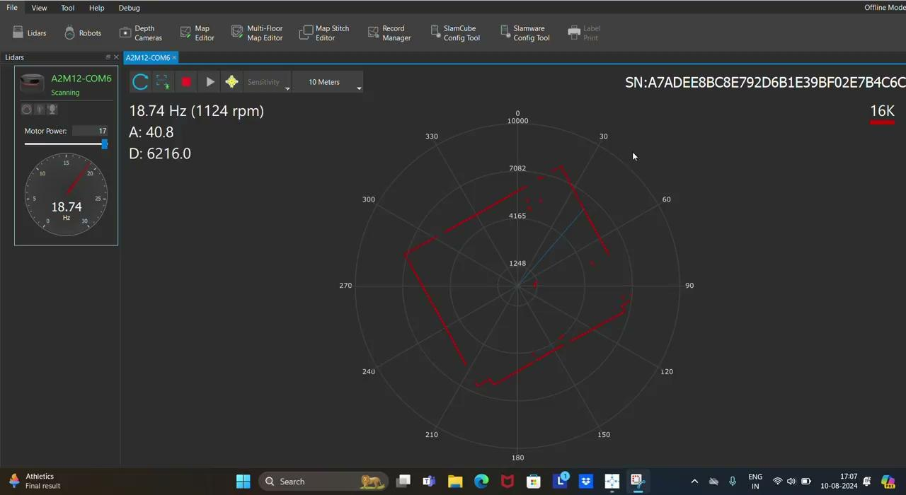

Slide 13
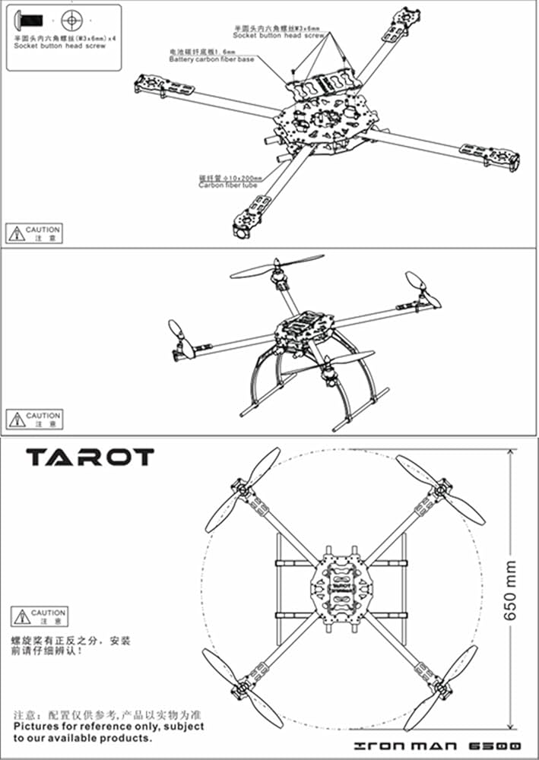
Assembly of Drone
Assemble the Frame
Mount Power Distribution Board
Install Motors
Attach Electronic Speed Controllers (ESCs)
Mount the flight controller & GPS
Wire the Flight Controller:
Install Propellers:
Attach Battery and Other Accessories
Check Connections and Calibrate

Slide 14
Calibration of Drone
1. Introduction to Mission Planner
2. Calibrating the Accelerometer
3. Calibrating the Compass
4. Calibrating the ESC.
5. Calibrating the Radio (RC Controller)

Slide 15
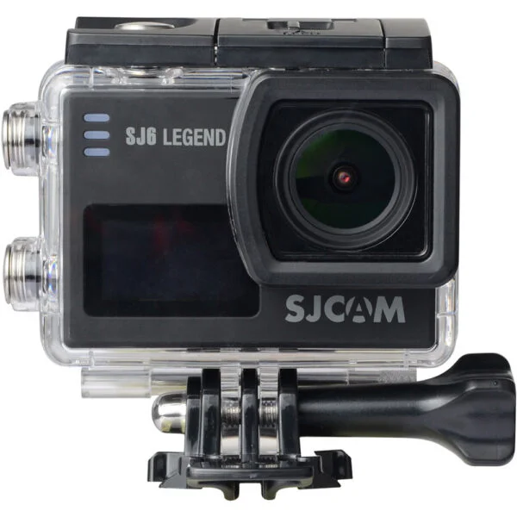
Camera
SJCAM SJ6 Legend
High-Quality Data: Captures 16MP images and 4K videos for detailed bridge mapping and analysis.
Stabilization Accuracy: Gyro stabilization reduces motion blur by approximately 30%, ensuring clear data capture during drone movement.
Field of View: The wide-angle lens provides a 166-degree field of view, covering large survey areas.
Versatile and Reliable: Performs well in various conditions, supporting continuous and accurate data collection for structural monitoring.
Battery Life: The 1000mAh battery provides up to 70 minutes of recording time at 4K resolution per charge.

Slide 16
Data Acquisition
High-Resolution Capture: The SJCAM SJ6 Legend camera captures high-resolution images and 4K videos of the bridge or building during the drone’s flight.
Aerial Survey: The drone is programmed to follow a specific flight path, capturing detailed visual data of the structure from various angles.
Real-Time Monitoring: The captured data is either stored on the camera’s microSD card or transmitted in real-time to a ground control station.
Data Transmission: If transmitted live, the drone uses wireless communication to send the data directly to the operator on the ground.
Post-Flight Analysis: After the flight, the stored images and videos are retrieved, processed, and analyzed to identify any defects or issues in the bridge or building.
Structural Health Monitoring: The data helps in detecting cracks, deformations, or other structural defects, enabling timely maintenance and repair.

Slide 17
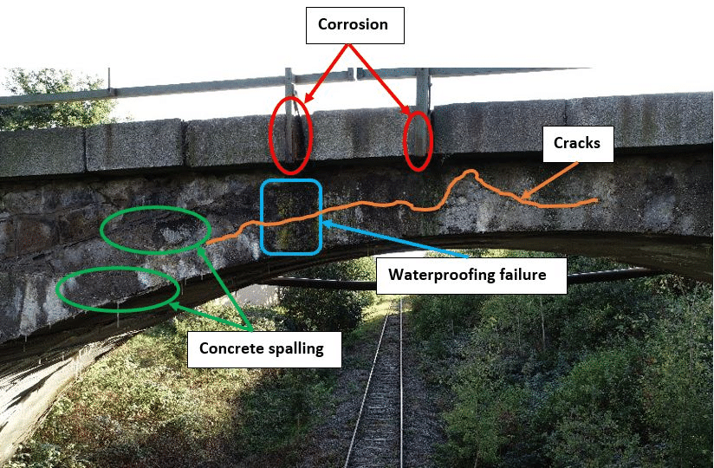
Data Processing
Image Acquisition
Image Preprocessing
Grayscale Conversion
Image Smoothing
Edge Detection
Contour Detection
Crack Identification
Post-Processing
Output Results

Slide 18
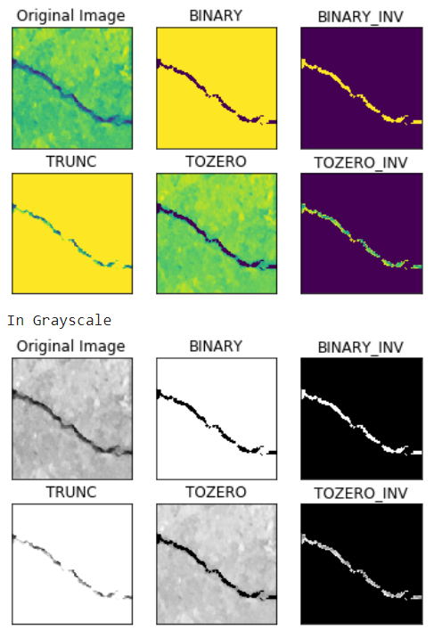
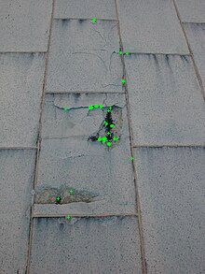

Slide 19
Conclusion
High Precision and Efficiency
Enhanced Safety
Cost-Effective Monitoring
Real-Time Data and Analytics
Versatility and Flexibility
Improved Data Quality for Structural Health Monitoring:
Integration with Other Technologies

Slide 20
Future Scope
Enhanced Data Collection and Analysis- Real-Time Monitoring, Automated Data Integration
Improved Construction Site Management- Site Condition Monitoring, Equipment Tracking and Maintenance
Advanced Safety and Risk Management- Hazard Detection, Emergency Response
Precision in Design and Construction- As-Built vs. Design Comparisons, Dynamic Updates
Optimized Project Management-Efficient Resource Allocation, Improved Scheduling
Enhanced Collaboration and Communication-Remote Monitoring
Future Trends and Considerations- Integration with AI and Machine Learning, Cost and Accessibility, Regulatory and Privacy Concerns

Slide 21
Thank You

